Slide 1


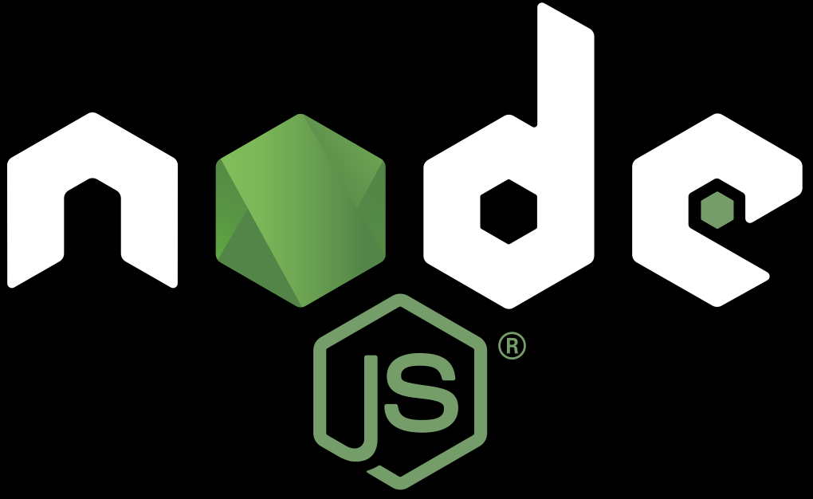
Case Study: Node JS On Kubernetes
Transition From Spot.io

Slide 2


Naor Tedgi (Abu Emma)
https://github.com/ntedgi
https://github.com/ntedgi/infra-meetings

Slide 3
Container Refactor
Graceful Shutdown
Why You Don't need Cluster Mode in K8s
Scheduled Tasks
Questions
Let’s get started

Slide 4
Container Refactor
In Kubernetes, we aim to utilize the scale-out deployment mechanism to enhance our system's scalability and performance
The deployment must be executed rapidly and with minimal startup time.

Slide 5
Container Refactor
In our current EC2 setup, we pull images from Amazon ECR that contain essential development tools, such as Python and g++.
Node.js relies on C++, Node-gyp, and Python to compile C++ add-ons.
Examples of such add-ons include:
node-rdkafka: A high-performance Kafka client.
bunyan-syslog: Streams logs to a syslog server.

Slide 6
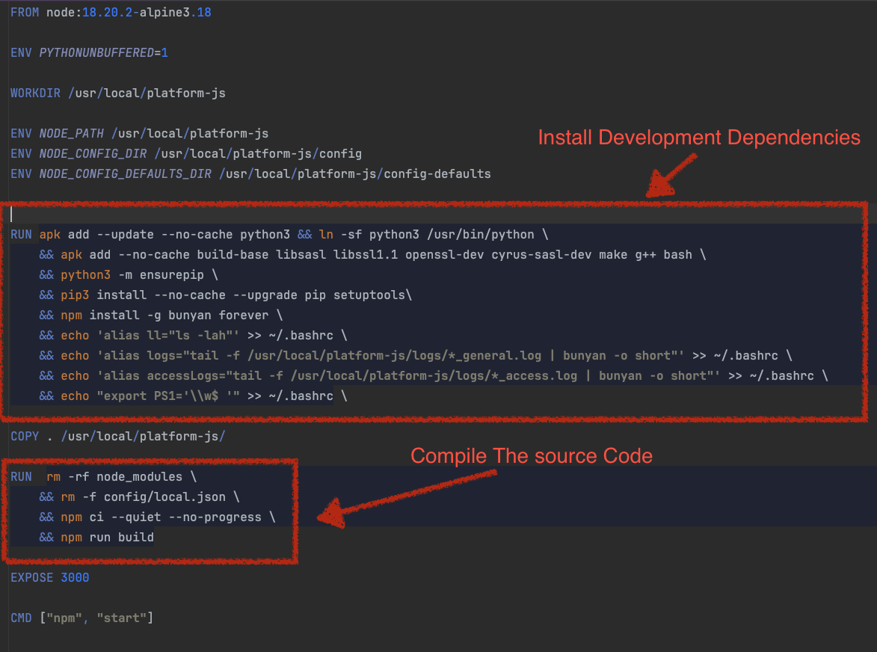

Slide 7
Upon EC2 startup, we first compile the code and then proceed to run the compiled application
#!/usr/bin/env bash
npm run build;
forever dist/app.js dist/apps/$1
Pulling image | Compile source code | Startup time

Slide 8
Container Refactor
Issues with this Approach:
Size of image (Disk size) for single pod / server in disk is contains a lot of OS utils and development dependencies that we don't need at runtime (do you need mocha or g++ on prod?)
The application startup time is slow because we need to first compile the code before running

Slide 9


Container Refactor

Slide 10
Container Refactor
To Run node app
Node engine installd
dist folder with js and add ons compiled
node-modules (only prod!)
Package.json (?)

Slide 11
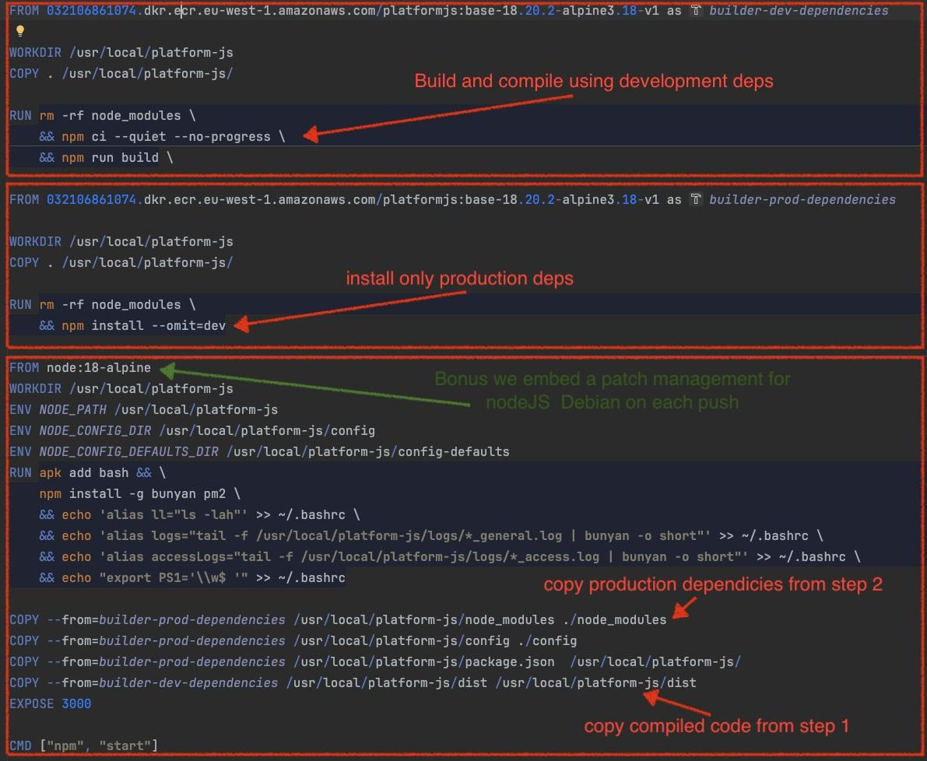

Slide 12
Container Refactor
We improve it by changing to different approach :
We move all our OS development Utils to different dockerfiles to reduce the time of installation when building the image and save it to ECR. Call it base-18.20-alpine
We use multi stage docker builder and from each steps only took the necessary output for runtime
We move this steps to new Docker file and save the container to private ECR platformjs:base-18.20.2-alpine3.18
Then with this base image we divide the process to 3 steps :
Intermediate docker 1 - Install all dependencies and compile the code into dist folder
Intermediate docker 2 - Install only production needed dependencies
Intermediate docker 3 - Copy the compiled code form step 1 , copy production dependencies from steps 2 and run

Slide 13

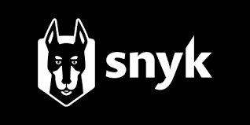
Container Refactor
Security Patch Management Automatically :
Run Time Layer (Docker Container)
Linux Distribution (OS)
Runtime Node Engine Version
Building Tools (GCC , Python , OpenSSL)
Application Layer (node dependencies)
Packages Update with semver Compatible
Provision Layer - (Spot EC2 instances OS, K8s Machines)
Host Linux Distribution (OS)

Slide 14
Container Refactor
Security Patch Management Automatically :

Slide 15
Container Refactor
Security Patch Management Automatically
You have a problem!
Notes:
you're not testing the code the your going to Deploy !!!!!

Slide 16
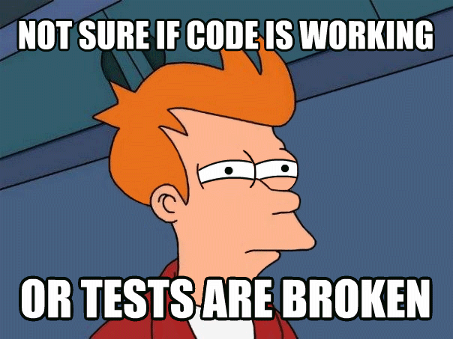
Container Refactor
You have a problem! you're not testing the code the your going to Deploy !!!!!

Slide 17
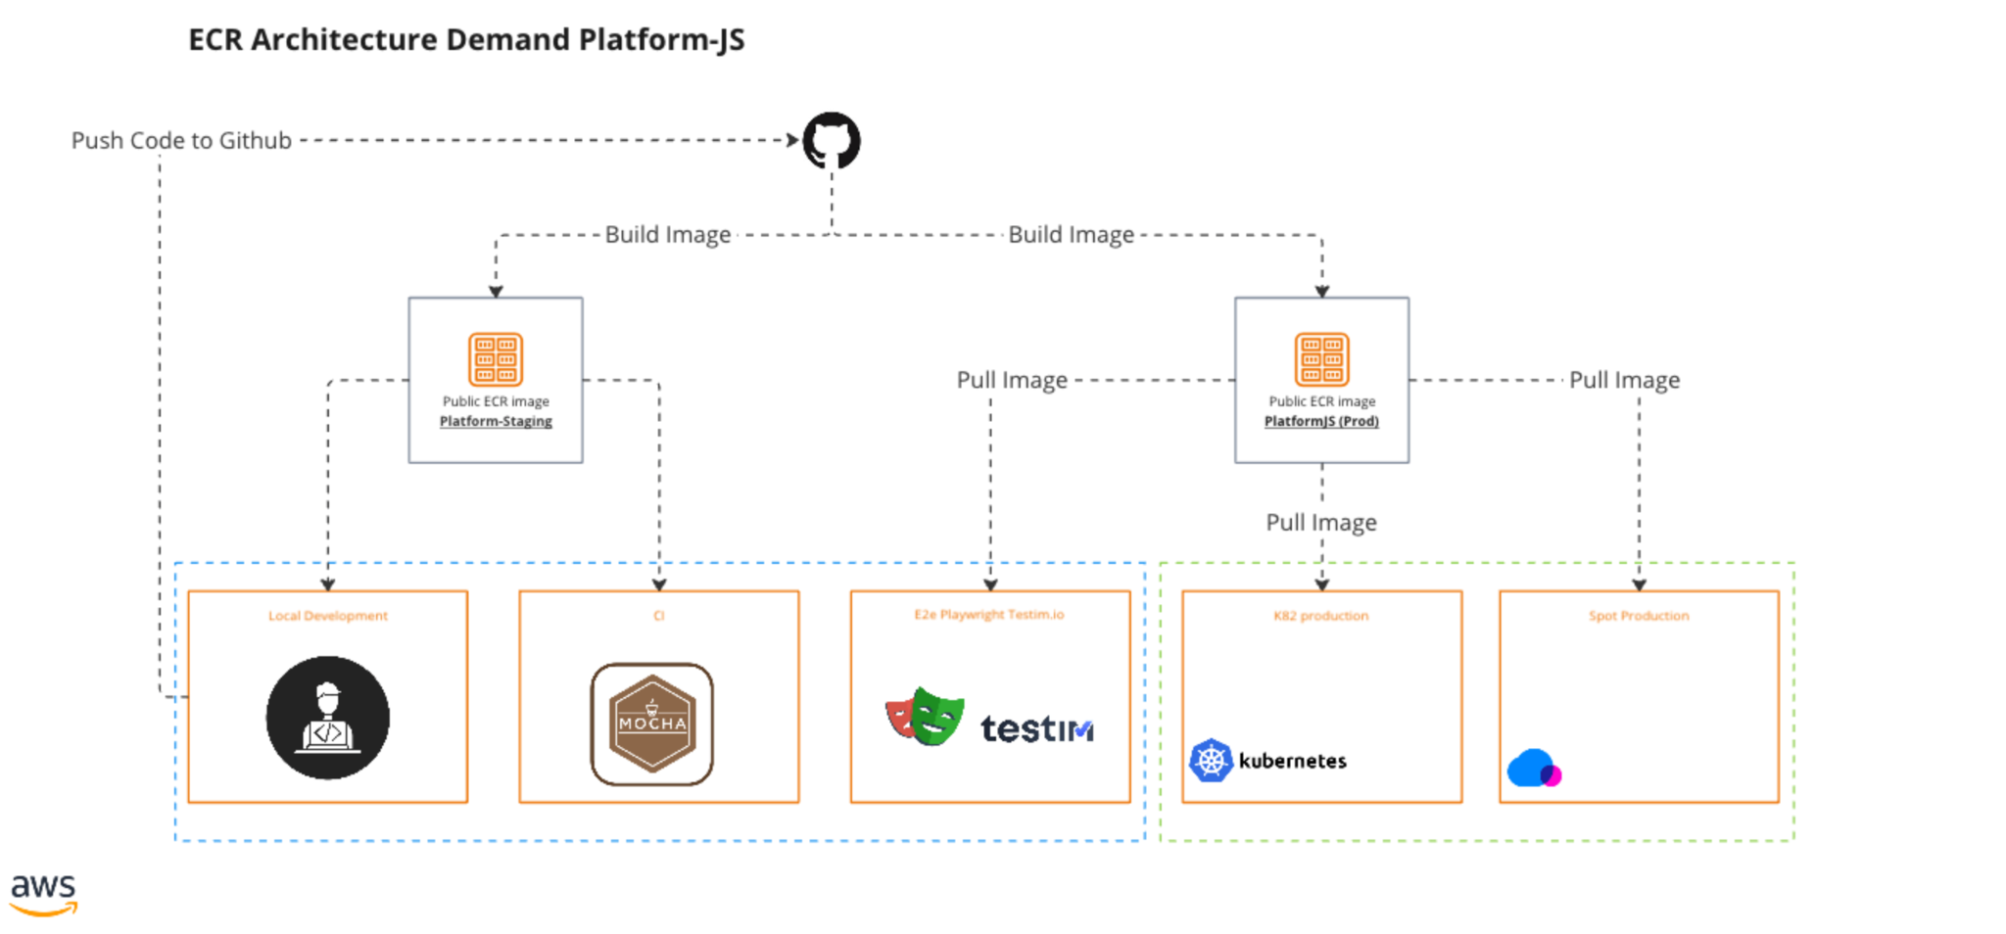
Container Refactor

Slide 18
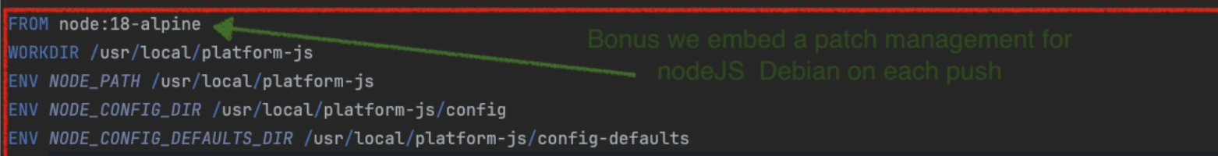
Container Refactor
Security Patch Management Automatically :
Run Time Layer (Docker Container)
Linux Distribution (OS)
Runtime Node Engine Version
Building Tools (GCC , Python , OpenSSL)

Slide 19
Container Refactor - Conclusions
Benefits:
Reduced Image Size:
The container images have been reduced from 705 MB to 284.22 MB, achieving an approximate reduction of 59.85%.

Slide 20
Container Refactor - Conclusions
Benefits:
Decreased Pull Time:
The time to pull images from Amazon Elastic Container Registry (ECR) has been reduced from 25 seconds to 11 seconds.
Eliminated Compilation Time:
There is no longer a need for compilation during the container build process.
Enhanced Security:
Automatic patch management is now in place, ensuring that the containers remain up-to-date with the latest security patches.
Pulling image | Compile source code | Startup time
Pulling image | Startup time

Slide 21
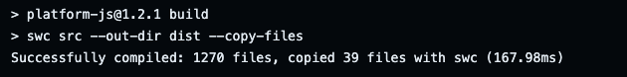
Container Refactor - Conclusions
Eliminated Compilation Time:
There is no longer a need for compilation during the container build process.
Now you can say compile source code? It's very fast
You're right but in order to do it in production you need to ship your container with all development dependencies!

Slide 22
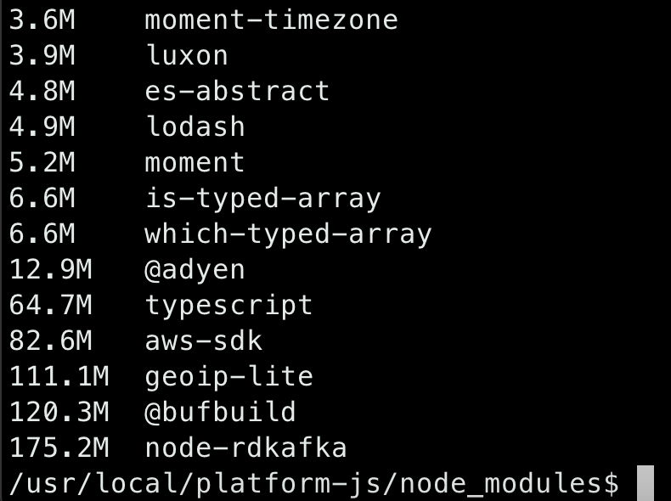
Container Refactor - Conclusions
We found out there is some dependencies that we use there deps are huge for example
Geoip-lite - we use only to get the ip address of request is 111 mb !!
We can reduce it to 10KB !!! by using https://github.com/pbojinov/request-ip

Slide 23
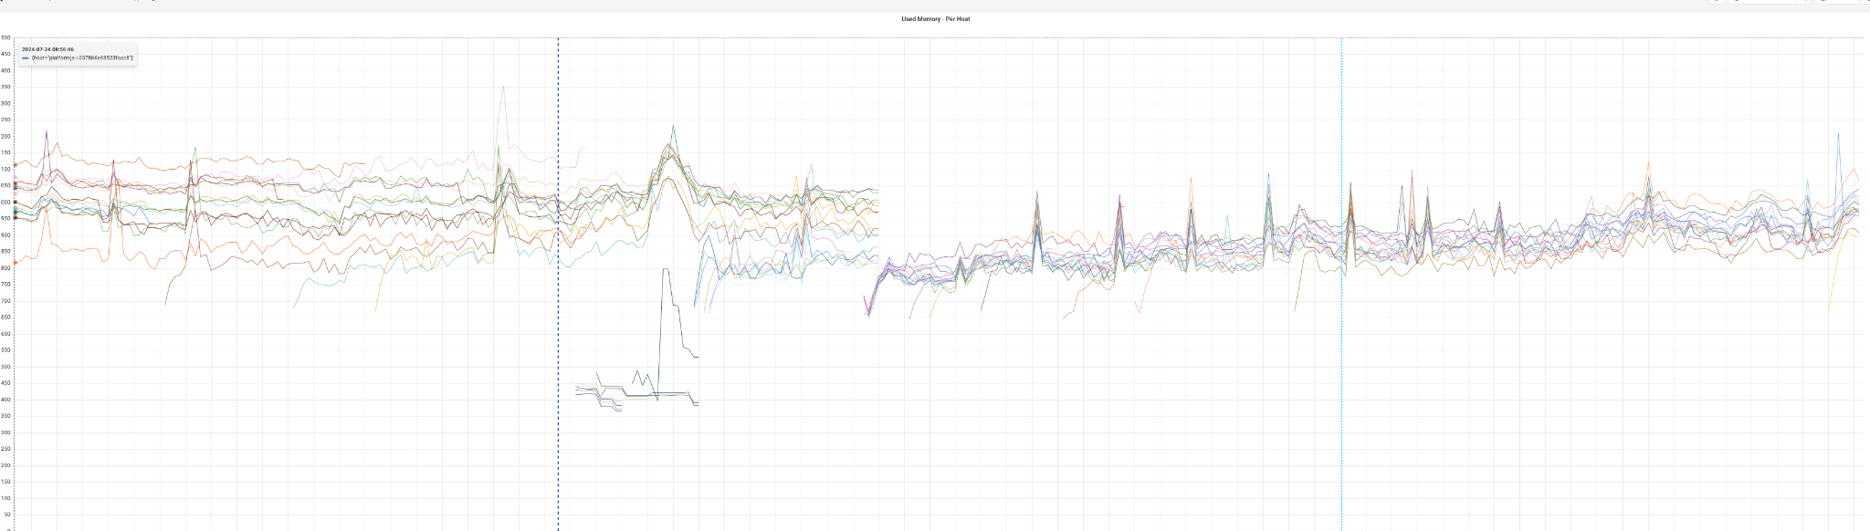
Container Refactor - Conclusions

Slide 24
Container Refactor
Graceful Shutdown
Why You Don't need Cluster Mode in K8s
Scheduled Tasks
Questions
Let’s get started

Slide 25
Graceful Shot Down
As mentioned on the first page, we aim to leverage the horizontal scaling capabilities of Kubernetes. Instead of scaling up, we will focus on scaling out by utilizing machines with lower resources. This approach, however, will result in a higher number of instances being started and shut down frequently.

Slide 26
Graceful Shot Down
The consequences of an abrupt shutdown can range from minor inconveniences to significant data loss, and degraded user experience.

Slide 27
Graceful Shot Down
Prevent data loss: If a service is shut down abruptly, any in-progress transactions or requests may be lost, leading to data corruption or data loss. A graceful shutdown ensures that all data is saved and any pending requests are processed before shutting down.
Avoid cascading failures: When a service goes offline, it can trigger a cascade of failures in other services that depend on it. A graceful shutdown allows dependent services to prepare for the outage and gracefully handle the failure.
Reduce downtime: By shutting down in a controlled manner, you can minimize the amount of downtime required for maintenance or updates. This helps keep the system up and running and reduces the impact on users.
Clean up resources: A service may be using resources such as file handles, database connections, or network sockets. A graceful shutdown allows the service to release these resources in a controlled manner, reducing the risk of resource leaks or conflicts with other services.

Slide 28

Graceful Shot Down
Naive Solution

Slide 29

Graceful Shot Down
Send Kill Signal
Naive Solution

Slide 30

Graceful Shot Down
Stop Incoming Traffic
Naive Solution

Slide 31
Graceful Shot Down
set terminationGracePeriodSeconds
to magic number (1m)
Naive Solution

Slide 32
Graceful Shot Down
Kill Pod
Naive Solution

Slide 33
Graceful Shot Down
Probably going to work

Slide 34

Graceful Shot Down
Probably going to work for 90% of use cases

Slide 35
Graceful Shot Down
Probably going to work for 90% of the cases
Issues with this approach.
Maybe 1m is not enough? To finish all running request
What about Kafka/sqs Consumers ?

Slide 36
Graceful Shot Down
After the application gets kill signal K8s stop sending request to that POD
In our application, we have implemented signal handling for SIGKILL, SIGINT, and SIGHUP signals. Upon receiving any of these signals, we monitor all active connections and ensure they are completed. After all active requests are finished, we proceed to close all connections to databases and message queues. Finally, we gracefully shut down our application, exiting with code 0.

Slide 37
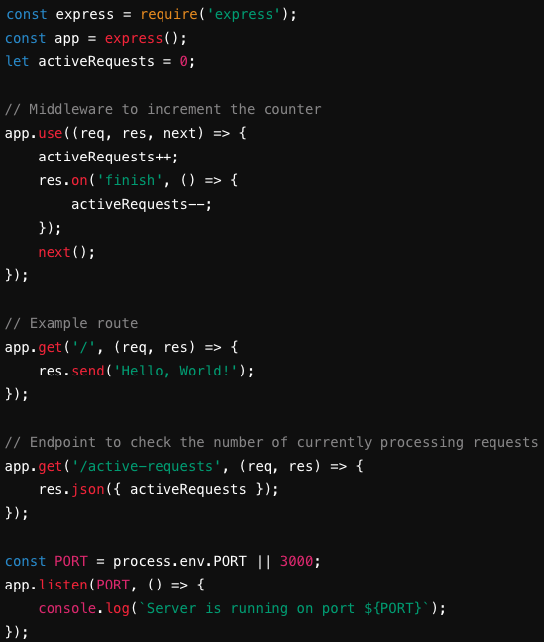
Graceful Shot Down
Count actively running requests

Slide 38
Graceful Shot Down
hooks are not executed asynchronously from the signal to stop the Container; the hook must complete its execution before the TERM signal can be sent.
Set PreStop Hook
https://kubernetes.io/docs/concepts/containers/container-lifecycle-hooks/

Slide 39
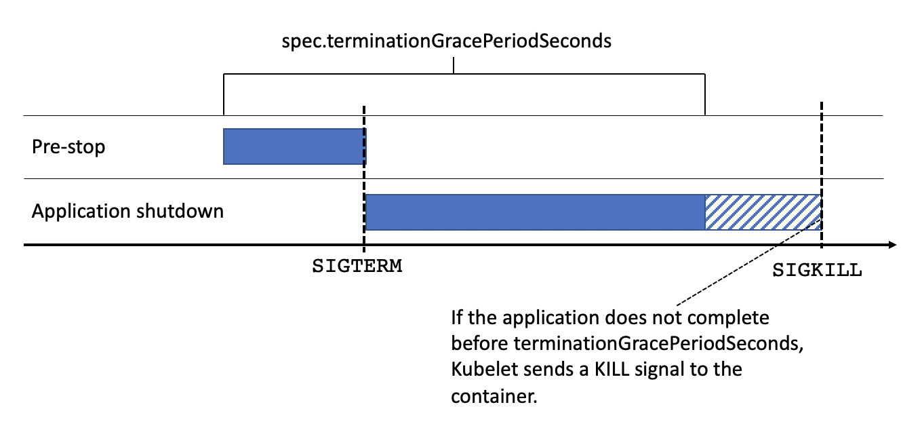
Graceful Shot Down
Set PreStop Hook

Slide 40
Graceful Shot Down
In PreStop Script
No incoming traffic arriving now
You can now wait for all running active request to finish (sleep)
Close Kafka Consumer
Disconnect from Mysql , Redis …
EXIT (0)
Then Let K8s killing the pod

Slide 41
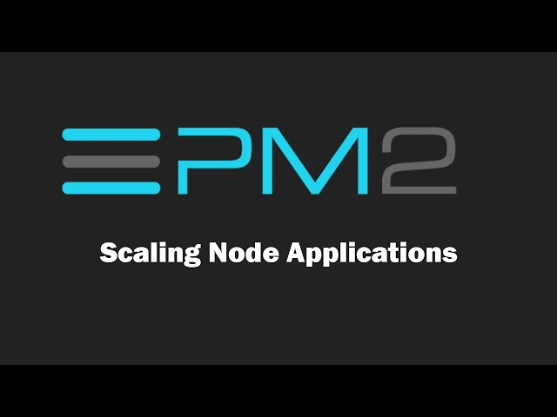

Graceful Shot Down
Because we have this orchestration , our deploy is much faster and a server can day safely (in peace)
We decide to stop using process manager tool like forever , PM2

Slide 42
Container Refactor
Graceful Shutdown
Why You Don't need Cluster Mode in K8s
Scheduled Tasks
Questions
Let’s get started

Slide 43
Why You Don't need Cluster Mode in K8s
There is all kind of server models for example
1. Thread-Per-Request
In this model, a new thread is created for each request received by the server.
Languages/Frameworks:
Java (Servlets): Traditional Java web applications using Servlets often used a thread-per-request model.
Python (WSGI frameworks like Flask, Django): When deployed with traditional WSGI servers, this model is sometimes used.
C++: Can implement thread-per-request with frameworks like Apache HTTP Server (with worker MPM).

Slide 44
Why You Don't need Cluster Mode in K8s
There is all kind of server models for example
1. Thread-Per-Connection
In this model, a new thread is created for each connection to the server, which then handles multiple requests over the same connection.
Languages/Frameworks:
Java (Blocking I/O servers): Older Java web servers, like Tomcat in its older configurations.
C/C++: Can be implemented in servers like Apache HTTP Server or Nginx (with specific modules).
Go: While Go tends to favor goroutines for concurrent connections, the pattern can be built with explicit threads.
Python: Servers like Twisted or Tornado could use this model for handling long-running connections.

Slide 45
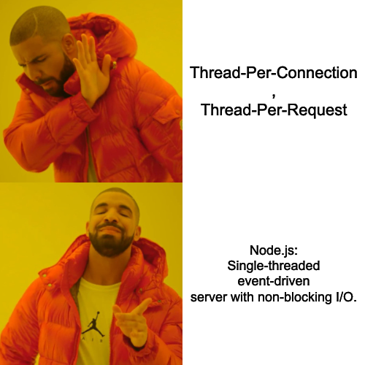
Why You Don't need Cluster Mode in K8s

Slide 46
Why You Don't need Cluster Mode in K8s
Why to use it in general?
How Many Threads Node uses By Default?

Slide 47
Why You Don't need Cluster Mode in K8s
Why to use it in general?
Code Interpreter
GC
Event Loop
4 Libuv threads for async tasks (net, fs ,dnslookup ..)
Note: UV_THREADPOOL_SIZE

Slide 48
Why You Don't need Cluster Mode in K8s
Single-Threaded Limitation: Node.js can’t utilize multiple CPU cores in a single process. Therefore, vertical scaling by adding more CPU cores may not always improve performance unless you use a clustering strategy (e.g., Node.js cluster module) within a pod.
Notes:
If you share data between worker thread it will probably help you
But if your app is stateless so why??

Slide 49
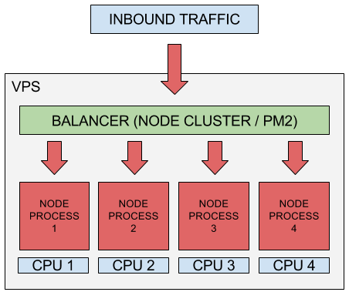

Slide 50
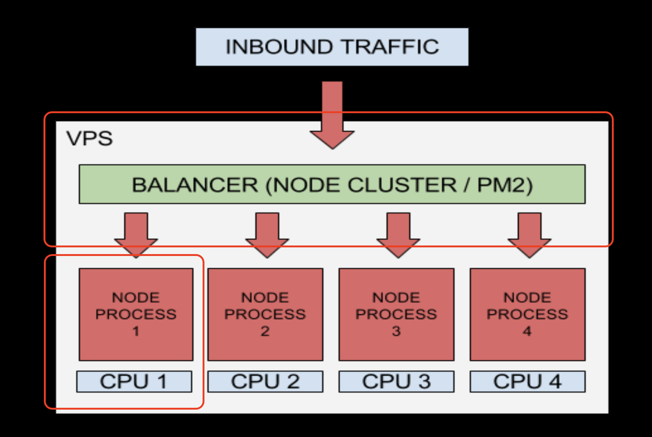
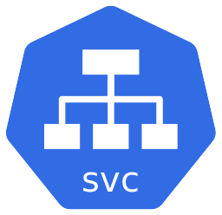

Slide 51
Why You Don't need Cluster Mode in K8s
If your app using mainly io/ops
If you don’t use communication between threads
If you don’t use heavy in memory data processing
So It better to scale horizontal and not vertical

Slide 52
Container Refactor
Graceful Shutdown
Why You Don't need Cluster Mode in K8s
Scheduled Tasks
Questions
Let’s get started

Slide 53
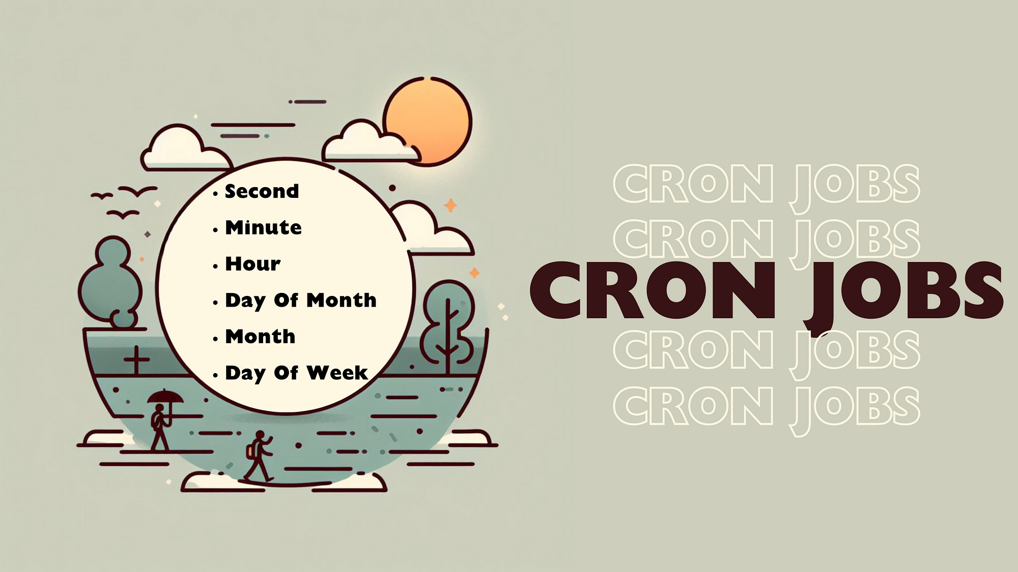
Scheduled Tasks

Slide 54
Scheduled Tasks
Today in EC2 we have :
Single Node Server That Run Multiple Cron Jobs on different times

Slide 55
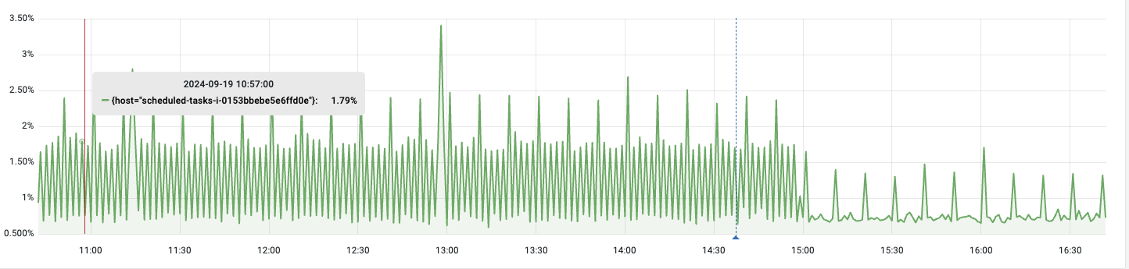
Scheduled Tasks
avg(100 - cpu_usage_idle {service="scheduled-tasks"}) by (host)

Slide 56

Scheduled Tasks
CPU Usage Between 2-5 percent

Slide 57
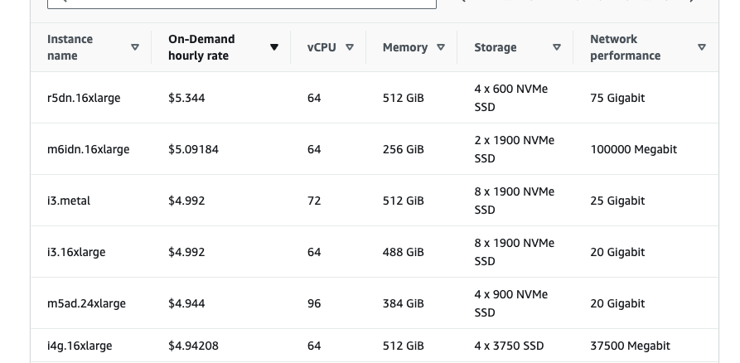
Scheduled Tasks
We are paying hourly no matter if the service is running or not so why not use it only when it runs?

Slide 58
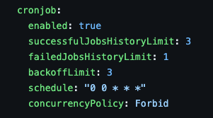
Scheduled Tasks
Deploy Pod -> Run Task -> Kill Pod

Slide 59
Container Refactor
Graceful Shutdown
Why You Don't need Cluster Mode in K8s
Scheduled Tasks
Questions
Let’s get started

Slide 60
Questions ?

Slide 61
Naor Tedgi (Abu Emma)
Thanks!
https://github.com/ntedgi
https://github.com/ntedgi/infra-meetings
Notes:
אנחנו מגייסים full stack

